Slide 1

Project Title - Healthcare Analytics for
Doctor Visits
Name - SHOAIB S W
College Name - East Point College of Engineering and Technology
Bengaluru , Karnataka

Slide 2

PROBLEM STATEMENT
Healthcare organizations collect large amounts of patient and doctor visit data, but it can be difficult to identify meaningful patterns from raw data.
This project aims to analyze doctor visit data to understand healthcare utilization patterns and examine how factors such as age, gender, income, illness, health status, and chronic conditions are related to doctor visits.

Slide 3
Project Description
Analyzes a healthcare dataset containing patient and doctor visit information.
Includes variables such as age, gender, income, illness, health status, and chronic conditions.
Performs data cleaning and data preparation.
Applies descriptive statistical analysis to understand the dataset.
Performs univariate, bivariate, and multivariate analysis.
Uses different data visualization techniques to identify patterns and relationships.
Analyzes factors associated with doctor visits and healthcare utilization.
Implemented using Python, Pandas, NumPy, Matplotlib, and Seaborn.

Slide 4

WHO ARE THE END USERS?
Healthcare Analysts – Analyze patient and doctor visit data.
Hospitals and Healthcare Organizations – Understand healthcare utilization patterns.
Healthcare Researchers – Study patterns and relationships in healthcare data.
Healthcare Administrators – Use analytical insights for healthcare planning.
Data Analytics Students – Learn and demonstrate healthcare data analysis techniques.

Slide 5

Technology Used
Programming Language: Python
Data Processing: Pandas, NumPy
Data Visualization: Matplotlib, Seaborn
Development Platform: Google Colab
Techniques: Data Cleaning, Data Preparation, Statistical Analysis, and Data Visualization

Slide 6
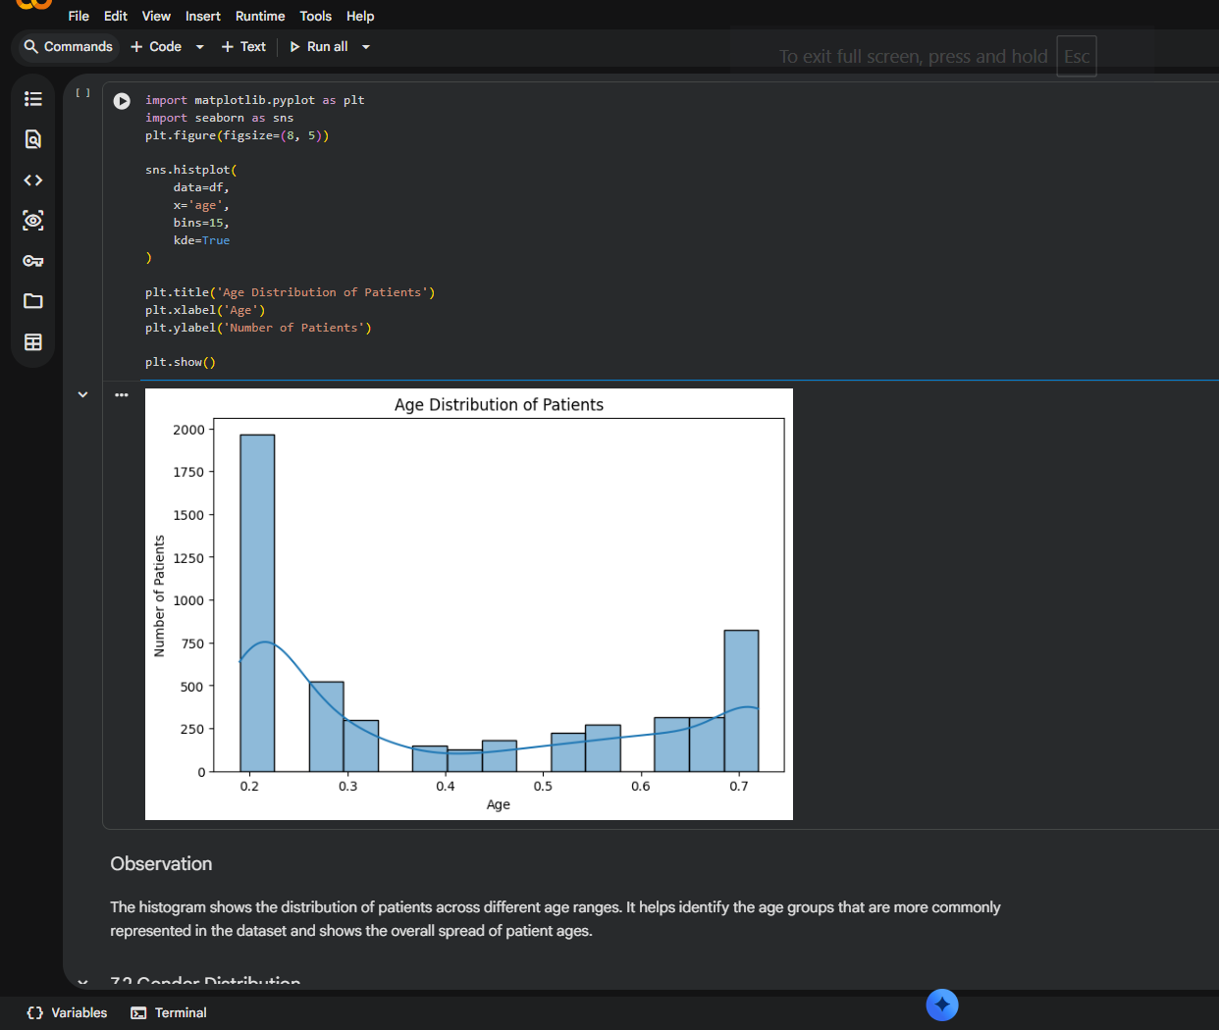
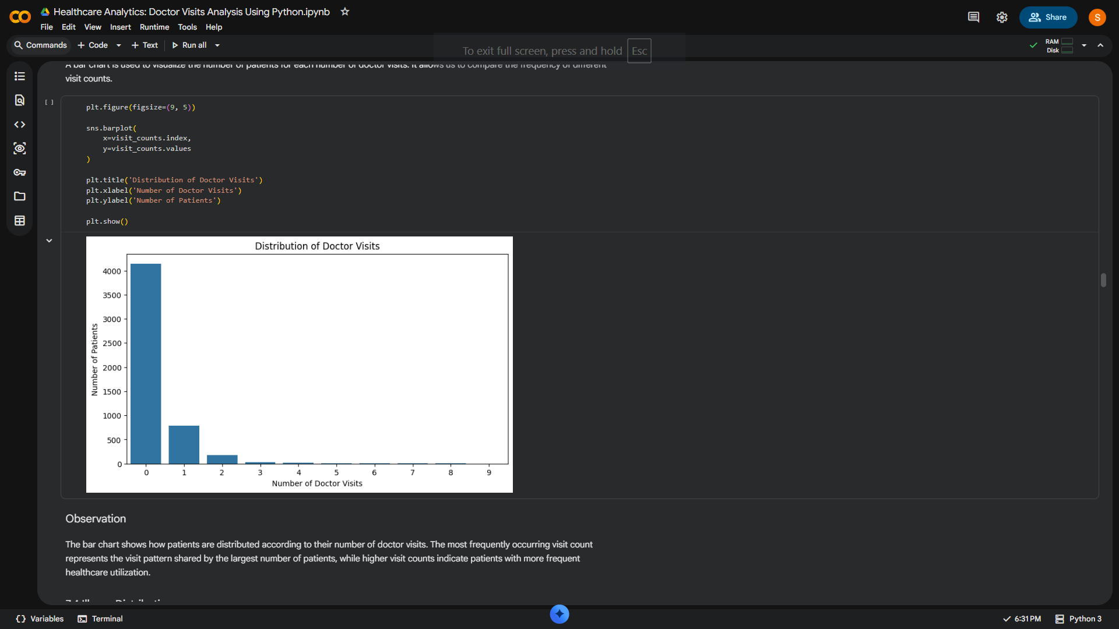
RESULTS
Demo Link

Slide 7
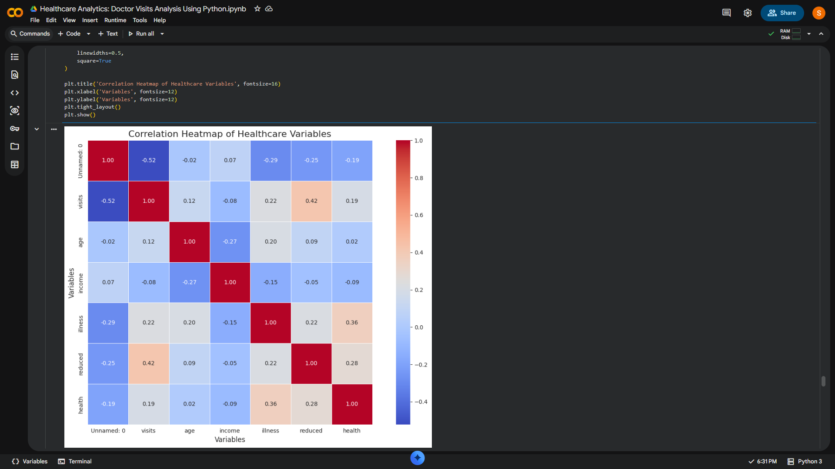
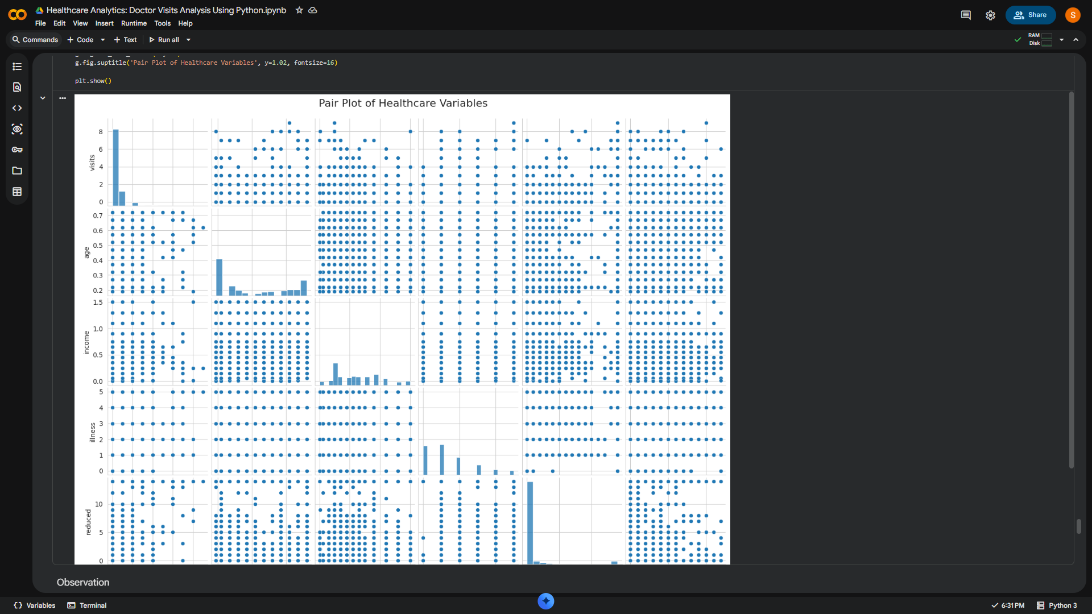
RESULTS
Demo Link

Slide 8
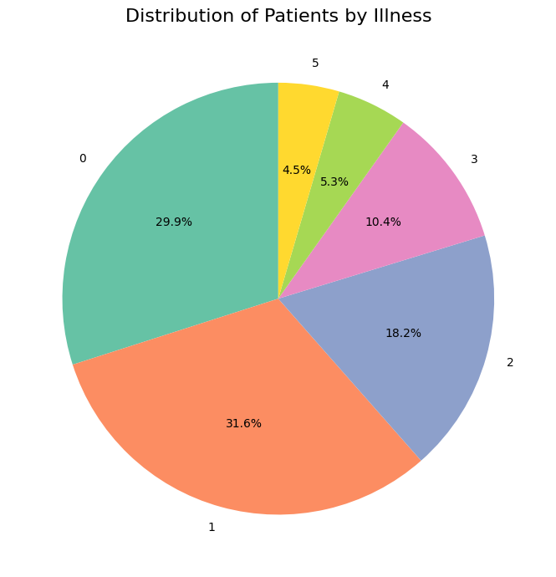
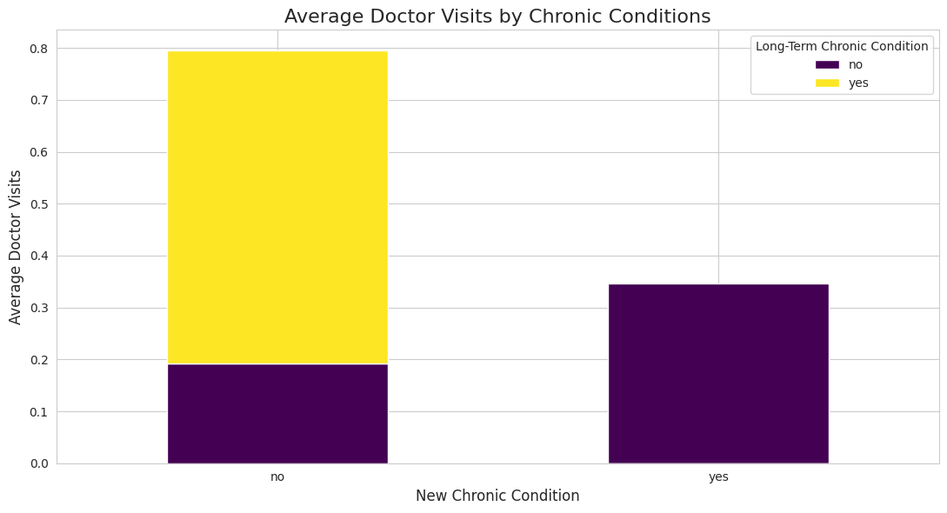
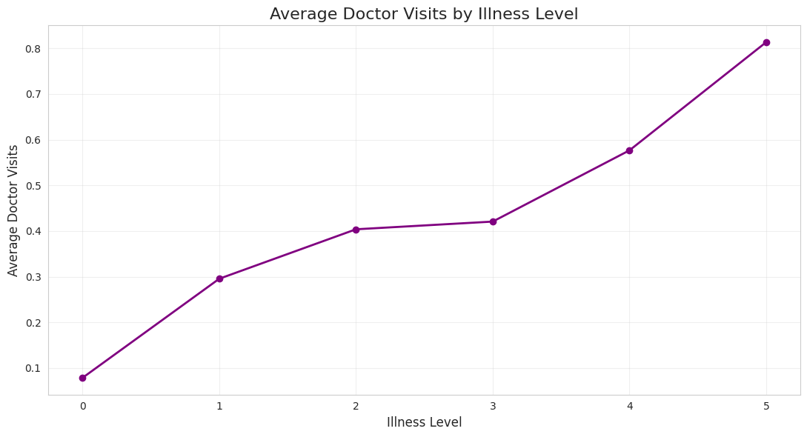
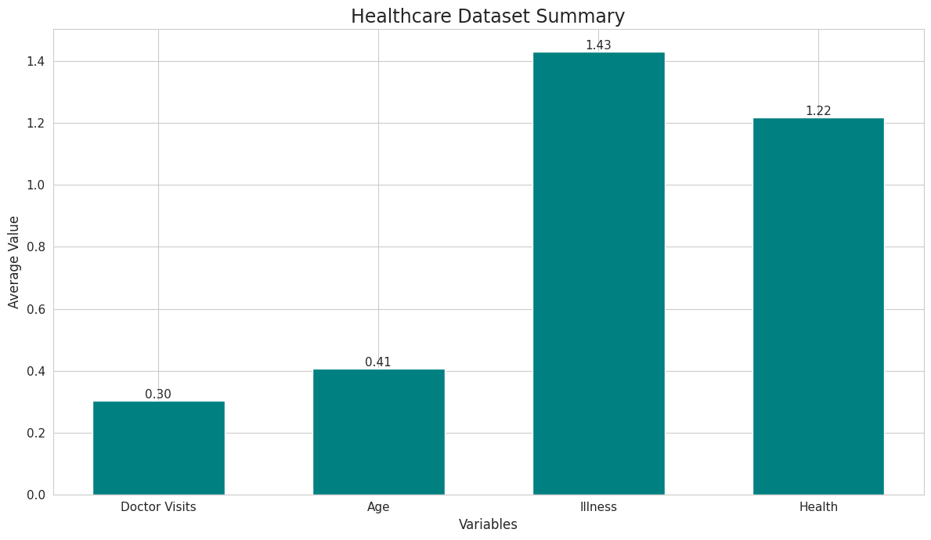
RESULTS
Demo Link

Slide 9
THANK YOU
Healthcare Analytics: Doctor Visits Analysis
GitHub Demo - https://github.com/Shoaib05504/Healthcare-Doctor-Visits-Analysis.git
.

